Slide 1


Sentiment Analysis on Beauty Products’ Review
Vera Ummugulsum Guzelsoy
January- 2021

Slide 2



Problem Definition
Problem Definition & Understanding
Data Retrieval
Data Wrangling
Text Preprocessing
Exploratory Data Analysis
Transforming Data
Preparing the Model
Training Model
Evaluation
Model Improvement &
Evaluation
Testing
Conclusion

Slide 3


Problem Definition
Problem Definition & Understanding
Data Retrieval
Data Wrangling
Text Preprocessing
Exploratory Data Analysis
Transforming Data
Preparing the Model
Training Model
Evaluation
Model Improvement &
Evaluation
Testing
Conclusion

Slide 4






Data Retrieval
Problem Definition & Understanding
Data Retrieval
Data Wrangling
Text Preprocessing
Exploratory Data Analysis
Transforming Data
Preparing the Model
Training Model
Binary Classification Model
Supervised Machine Learning Algorithms with NLP Sentiment Analysis
Evaluation
Model Improvement &
Evaluation
Testing
Conclusion

Slide 5
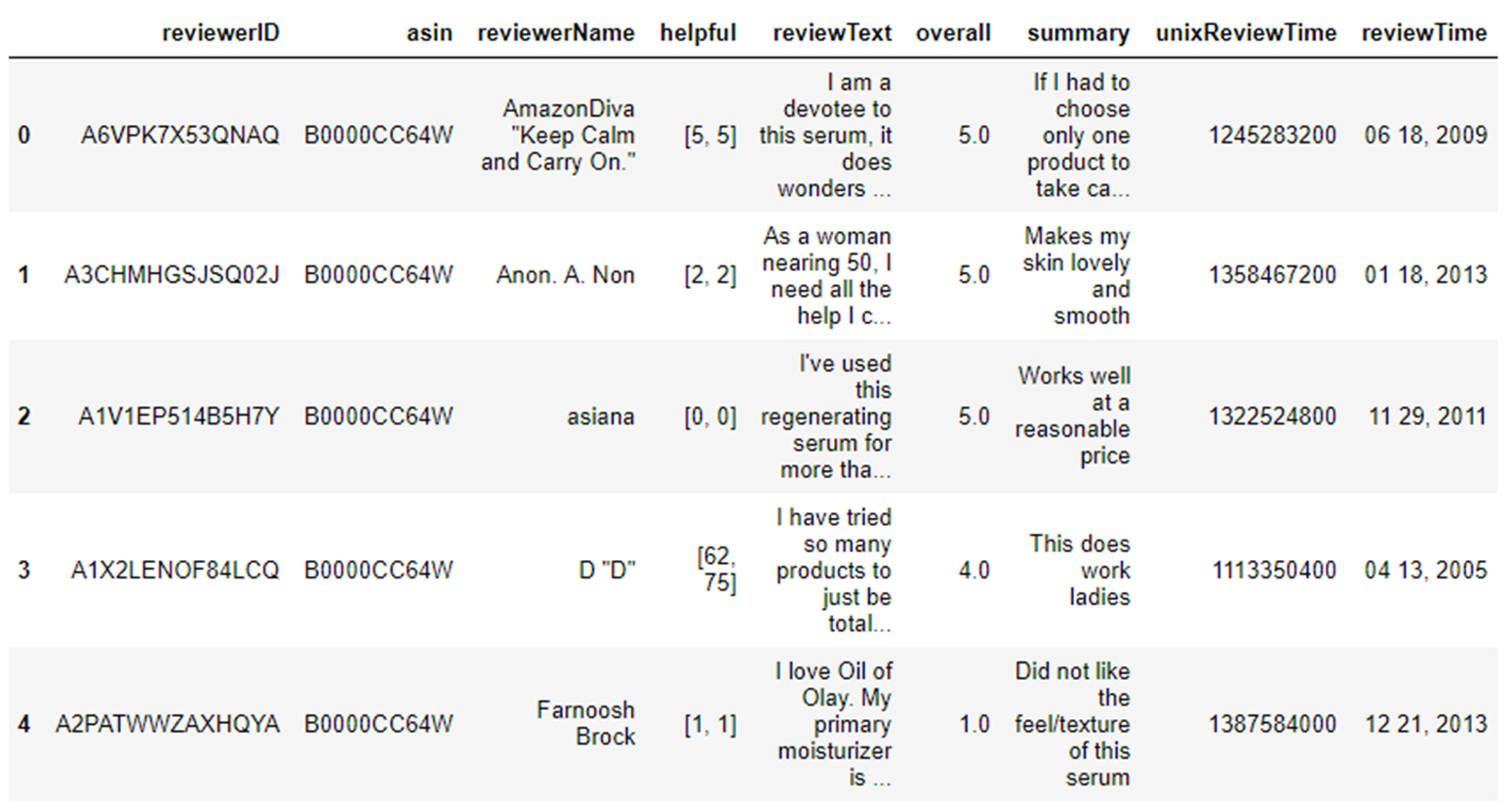
Data Wrangling – Data Information
Problem Definition & Understanding
Data Retrieval
Data Wrangling
Text Preprocessing
Exploratory Data Analysis
Transforming Data
Preparing the Model
Training Model
Evaluation
Model Improvement &
Evaluation
Testing
28798 Rows(Reviews), 9 Columns(Variables)
Conclusion

Slide 6
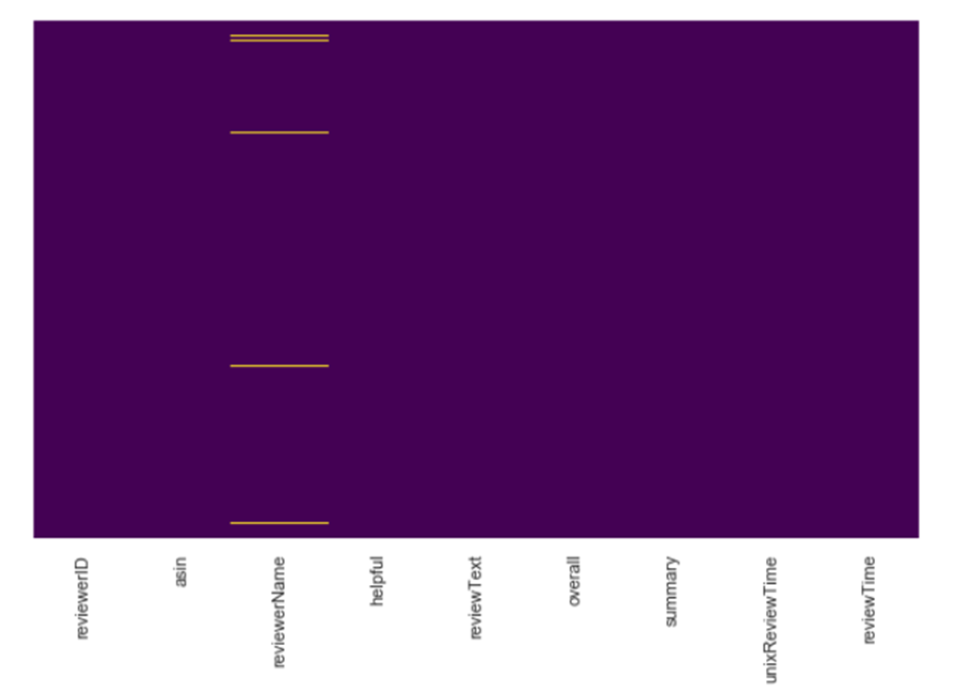


Data Wrangling – Missing & Duplicate Values
Problem Definition & Understanding
Data Retrieval
Data Wrangling
Text Preprocessing
Exploratory Data Analysis
Transforming Data
Preparing the Model
Training Model
Evaluation
Model Improvement &
Evaluation
Testing
Conclusion

Slide 7
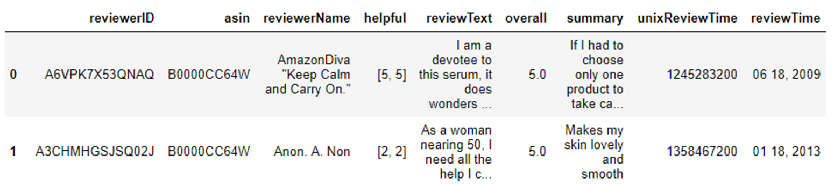
Data Wrangling
Problem Definition & Understanding
Data Retrieval
Data Wrangling
Text Preprocessing
Exploratory Data Analysis
Transforming Data
Preparing the Model
Concatenate the texts
Drop ‘helpful’ feature
Rearrange ‘Overall’ feature
Rearrange ‘reviewerID’ and ‘reviewerName’
Rearrange ‘unixReviewTime’ and ‘reviewTime’
Training Model
Evaluation
Model Improvement &
Evaluation
Testing
Conclusion

Slide 8
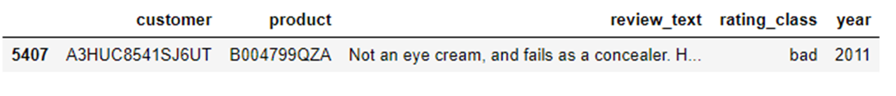
Data Wrangling – Rename Features
Problem Definition & Understanding
Data Retrieval
Data Wrangling
Sample
Text Preprocessing
Exploratory Data Analysis
Transforming Data
Preparing the Model
reviewerID : "customer"
asin : "product"
reviewText: This will be concatenated with "summary" and renamed as "review_text"
overall: "rating_class“
reviewTime: "year"
Training Model
Evaluation
Model Improvement &
Evaluation
Testing
Conclusion

Slide 9
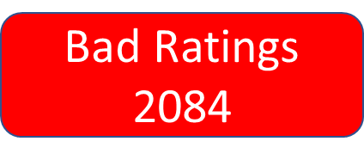

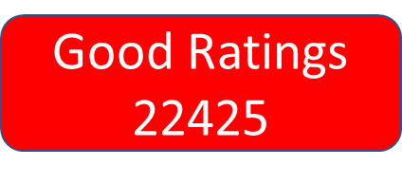
Data Wrangling – Descriptive Statistics
Problem Definition & Understanding
Data Retrieval
Data Wrangling
Text Preprocessing
Exploratory Data Analysis
Transforming Data
Preparing the Model
Training Model
Evaluation
Model Improvement &
Evaluation
Testing
Imbalanced Dataset
Conclusion

Slide 10





Data Wrangling – Descriptive Statistics
Problem Definition & Understanding
Data Retrieval
Data Wrangling
Text Preprocessing
Exploratory Data Analysis
Transforming Data
Preparing the Model
Training Model
Evaluation
Model Improvement &
Evaluation
Testing
18 Reviews
for Products
34 Reviews
for Each Product
Conclusion

Slide 11





Text Preprocessing
Problem Definition & Understanding
Data Retrieval
Data Wrangling
Text Preprocessing
Exploratory Data Analysis
Transforming Data
Preparing the Model
Training Model
Evaluation
Model Improvement &
Evaluation
Testing
Conclusion

Slide 12


Text Preprocessing
Problem Definition & Understanding
Data Retrieval
Noisy Entity Removal
Text Normalization
Word Standardization
Raw
Data
Cleaned
Data
Data Wrangling
Text Preprocessing
Remove tags
Remove accented characters
Expand contractions
Remove special characters
Lemmatization versus Stemming
Removing stopwords
Tokenization
Remove extra white space and digits
Spelling corrections
Grammatical Corrections
Remove repeated characters
Lower the text
Exploratory Data Analysis
Save the df to csv file
Transforming Data
Preparing the Model
Training Model
Evaluation
Model Improvement &
Evaluation
Testing
Conclusion

Slide 13
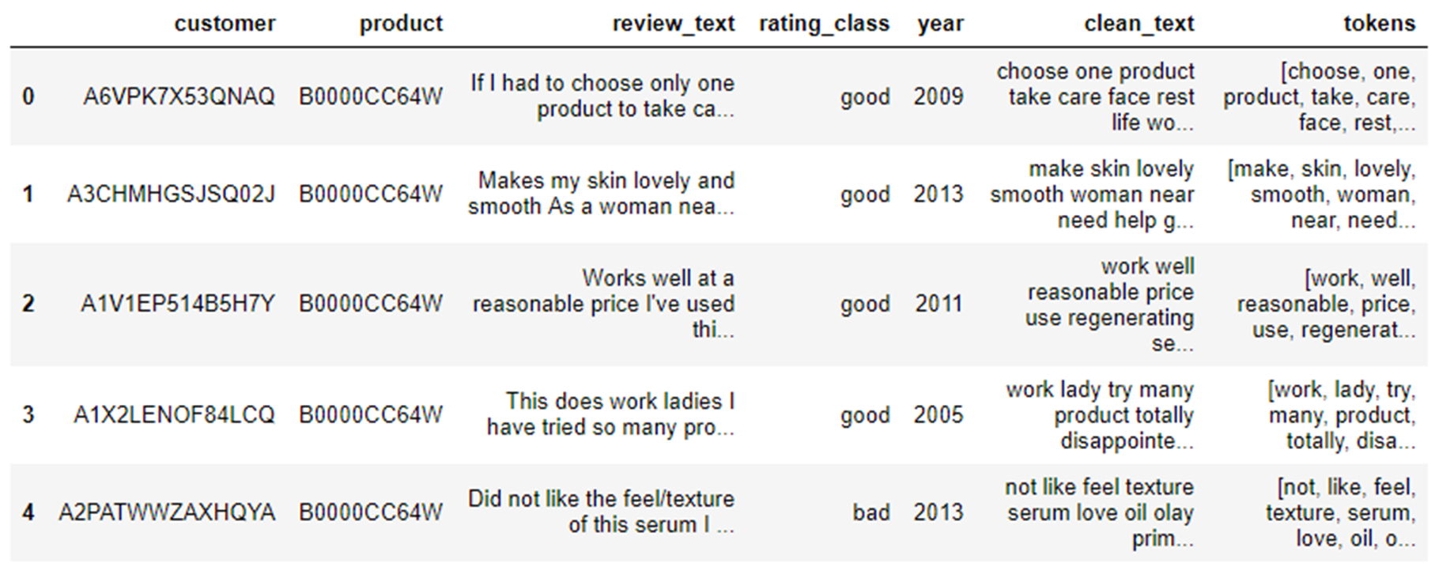
Text Preprocessing
Problem Definition & Understanding
Data Retrieval
Data Wrangling
Text Preprocessing
Exploratory Data Analysis
Transforming Data
Preparing the Model
Training Model
Evaluation
Model Improvement &
Evaluation
Testing
Conclusion

Slide 14
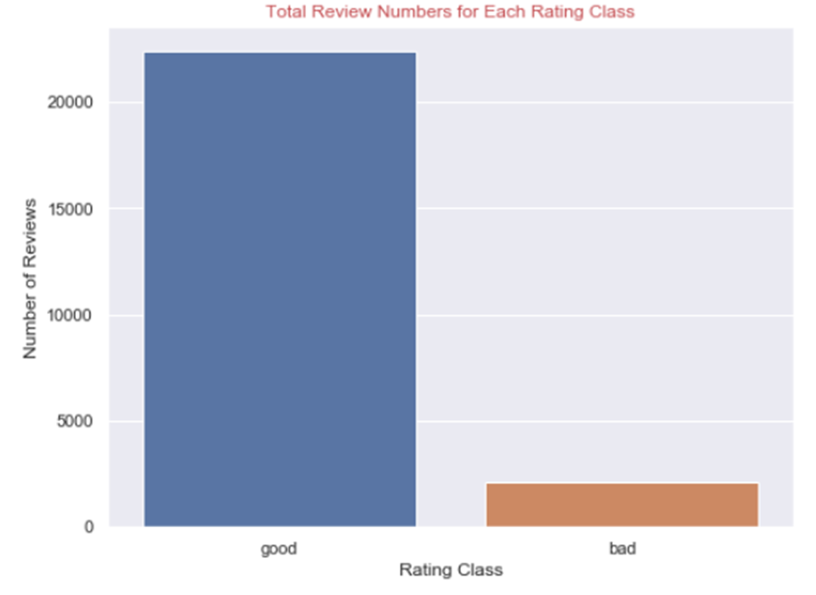


Exploratory Data Analysis – Target Variable
Problem Definition & Understanding
Data Retrieval
Data Wrangling
Text Preprocessing
Exploratory Data Analysis
Transforming Data
Preparing the Model
Training Model
Evaluation
Model Improvement &
Evaluation
Testing
Conclusion

Slide 15
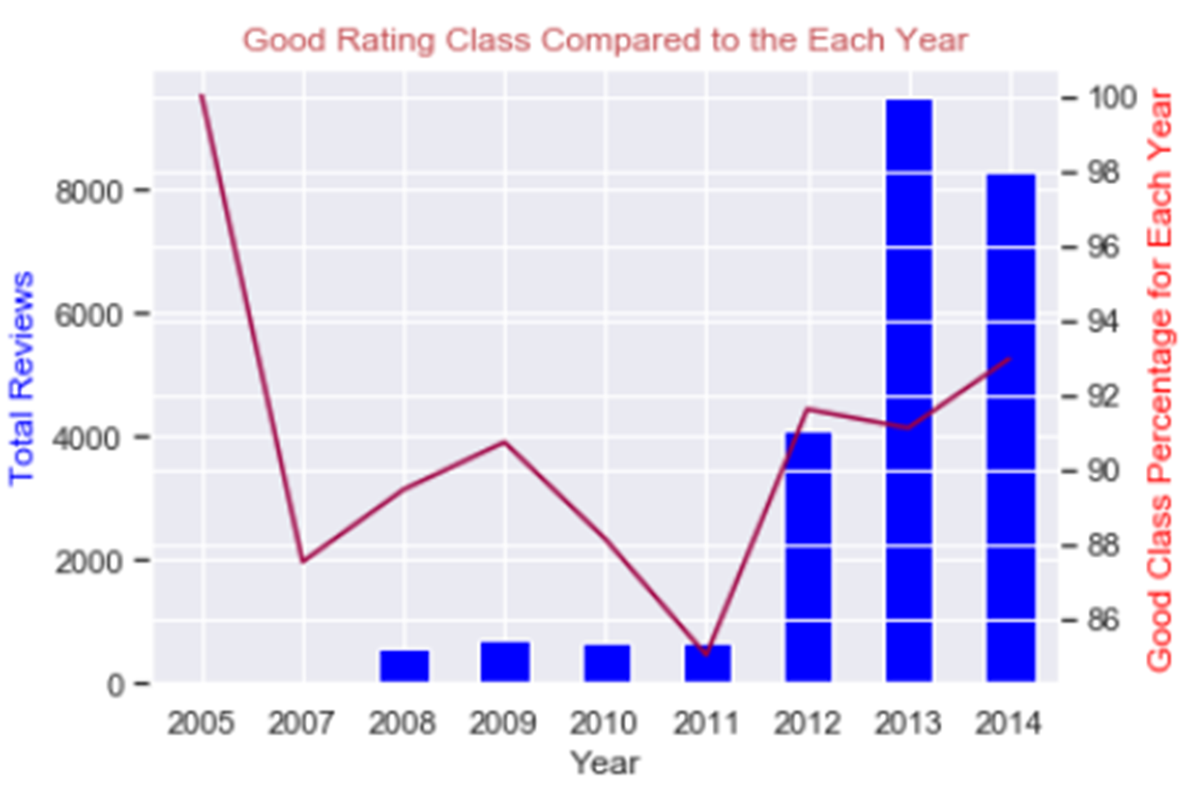
Exploratory Data Analysis – ‘Year’ Feature
Problem Definition & Understanding
Data Retrieval
Data Wrangling
Text Preprocessing
Exploratory Data Analysis
Transforming Data
Preparing the Model
Training Model
Evaluation
Model Improvement &
Evaluation
Testing
Conclusion

Slide 16
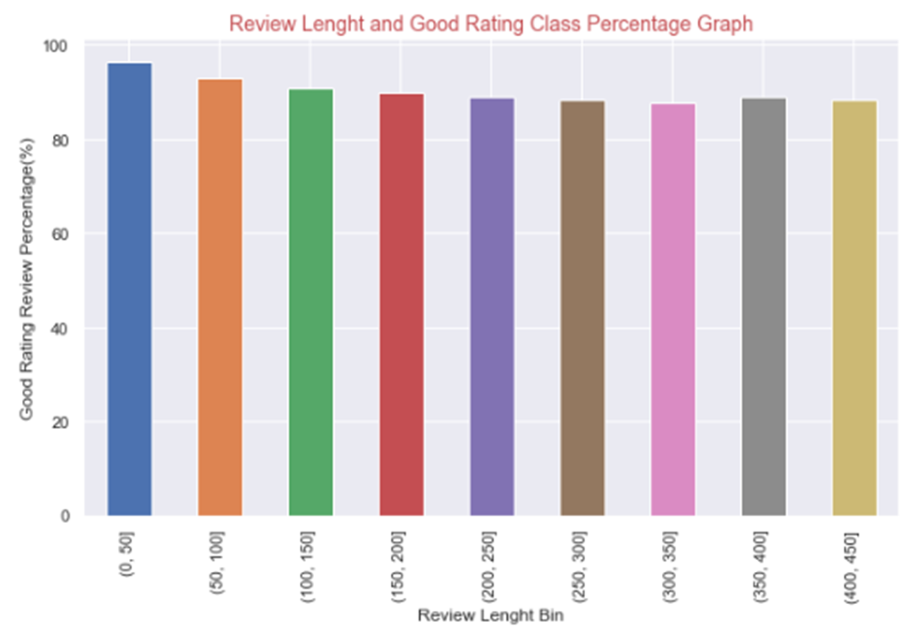
Exploratory Data Analysis – ‘Review Length’ Feature
Problem Definition & Understanding
Data Retrieval
Data Wrangling
Text Preprocessing
Exploratory Data Analysis
Transforming Data
Preparing the Model
Training Model
Evaluation
Model Improvement &
Evaluation
Testing
Conclusion

Slide 17
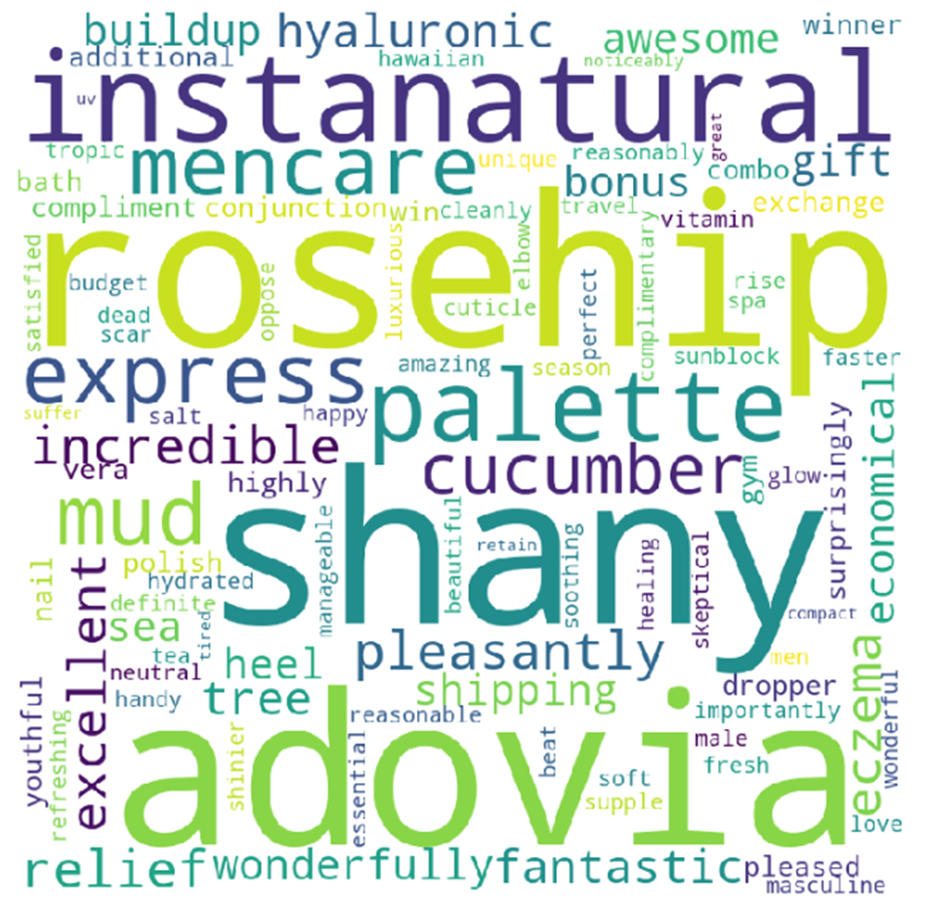
Exploratory Data Analysis – ‘Text Review’ Feature
Problem Definition & Understanding
Data Retrieval
Data Wrangling
Text Preprocessing
Exploratory Data Analysis
Transforming Data
Good Rating Words
Preparing the Model
Training Model
Evaluation
Model Improvement &
Evaluation
Testing
Conclusion

Slide 18
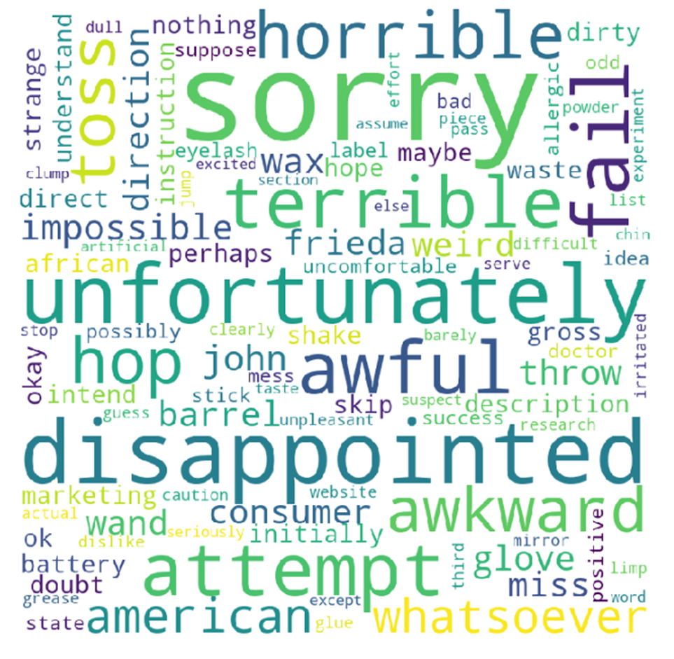

Exploratory Data Analysis – ‘Text Review’ Feature
Problem Definition & Understanding
Data Retrieval
Data Wrangling
Text Preprocessing
Exploratory Data Analysis
Transforming Data
Preparing the Model
Training Model
Evaluation
Model Improvement &
Evaluation
Testing
Conclusion

Slide 19

Transforming Data
Problem Definition & Understanding
Data Retrieval
Data Wrangling
Text Preprocessing
Separating
Response Variable and Feature
X = df2['clean_text']
y = df2['rating_class']
Exploratory Data Analysis
Transforming Data
Splitting Dataset
into Training and Test Set
Test Size = 25%
Stratified Sampling
Preparing the Model
Training Model
Evaluation
Train Set Shape : (18381,)
Test Set Shape : (6128,)
Model Improvement &
Evaluation
Testing
Conclusion

Slide 20
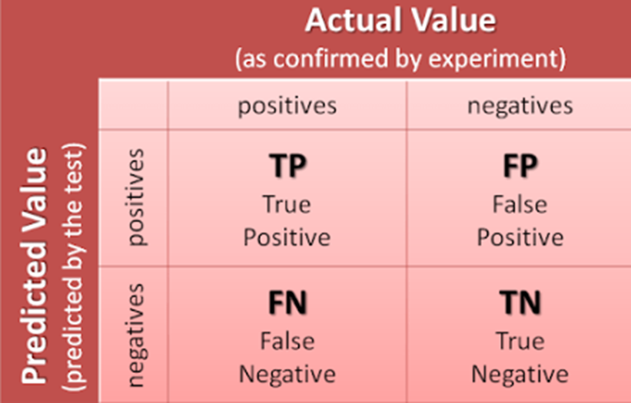
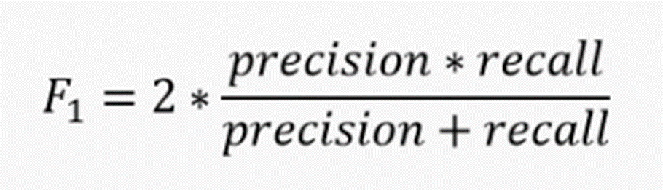
Selecting the Right Evaluation Metric
Problem Definition & Understanding
Data Retrieval
Data Wrangling
Text Preprocessing
Exploratory Data Analysis
Transforming Data
Preparing the Model
Training Model
Evaluation
Model Improvement &
Evaluation
Testing
Conclusion

Slide 21

Apply Vectorizing
Problem Definition & Understanding
Data Retrieval
Data Wrangling
Text Preprocessing
CountVectorizer
Turning a collection of text documents into numerical feature vectors.
Exploratory Data Analysis
Transforming Data
TF-IDF
Preparing the Model
Training Model
Evaluation
Hashing Vectorizer
Model Improvement &
Evaluation
Testing
Conclusion

Slide 22

Training Model
Problem Definition & Understanding
Data Retrieval
Data Wrangling
Logistic Regression
Text Preprocessing
Exploratory Data Analysis
Random Forest
Transforming Data
Supervised
Machine Learning
Classification
Models
Preparing the Model
Naïve Bayes
Training Model
Evaluation
XGBoost
Model Improvement &
Evaluation
Baseline Classifier (DummyClassifier)
Pre-trained model(Word2Vec)
Testing
CatBoost
Conclusion

Slide 23

Dummy Classifier
Problem Definition & Understanding
Data Retrieval
Data Wrangling
Text Preprocessing
Exploratory Data Analysis
Transforming Data
Preparing the Model
Training Model
Evaluation
Model Improvement &
Evaluation
Testing
f1 score: 0.84
Conclusion

Slide 24
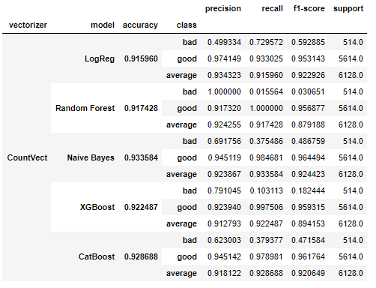
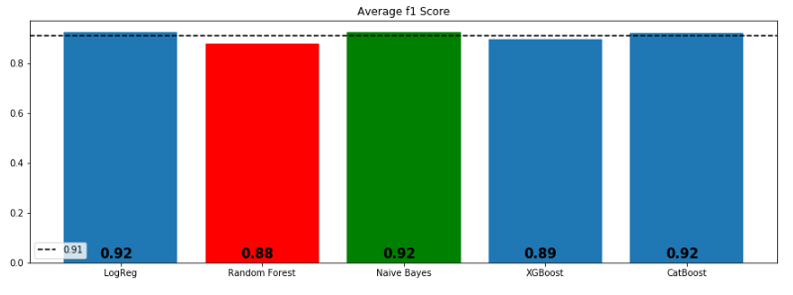
Count-Vectorizing and Algorithms
Problem Definition & Understanding
Data Retrieval
Data Wrangling
Text Preprocessing
Exploratory Data Analysis
Transforming Data
Preparing the Model
Training Model
Evaluation
Model Improvement &
Evaluation
Testing
Conclusion

Slide 25
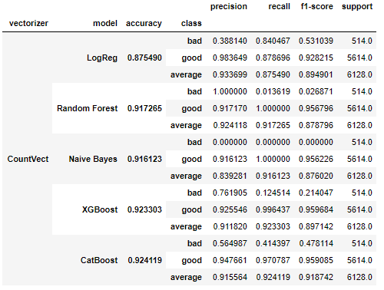
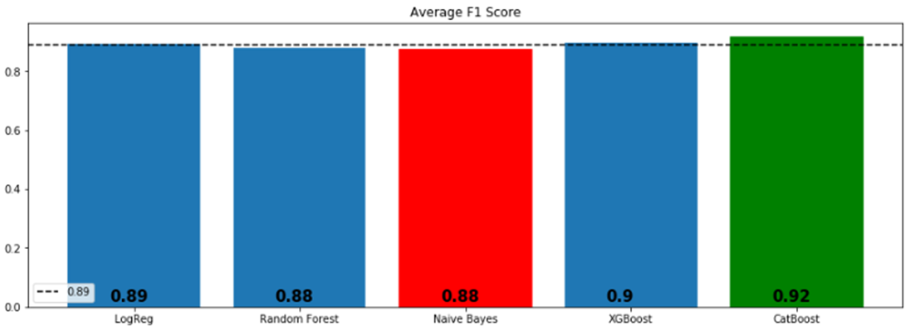
TF-IDF and Algorithms
Problem Definition & Understanding
Data Retrieval
Data Wrangling
Text Preprocessing
Exploratory Data Analysis
Transforming Data
Preparing the Model
Training Model
Evaluation
Model Improvement &
Evaluation
Testing
Conclusion

Slide 26
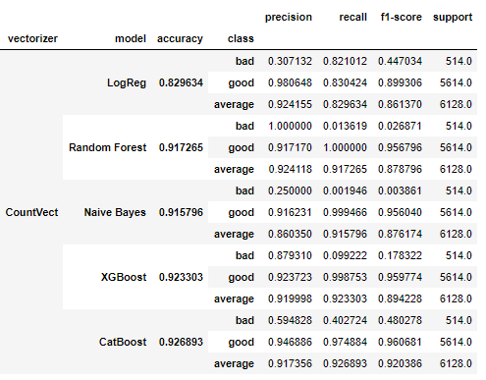
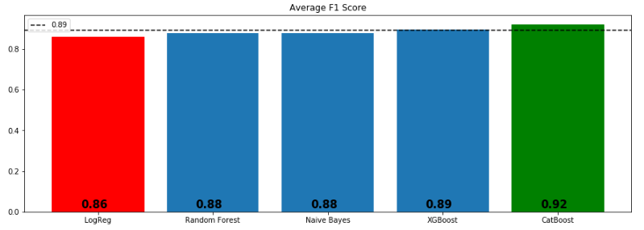
Hashing Vectorizing and Algorithms
Problem Definition & Understanding
Data Retrieval
Data Wrangling
Text Preprocessing
Exploratory Data Analysis
Transforming Data
Preparing the Model
Training Model
Evaluation
Model Improvement &
Evaluation
Testing
Conclusion

Slide 27

Model Improvement & Evaluation
Problem Definition & Understanding
Data Retrieval
Data Wrangling
Text Preprocessing
Exploratory Data Analysis
Transforming Data
Preparing the Model
* Text Cleaning
* Adjusting threshold for minimum and maximum occurrence of words in the document
* Hyperparameter tuning
* Feature Selection (SVD, PCA)
* Ensemble modeling
Training Model
Evaluation
Model Improvement &
Evaluation
Testing
Conclusion

Slide 28
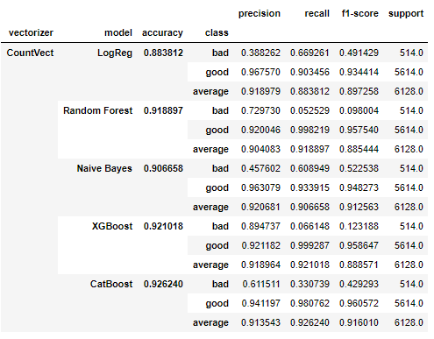
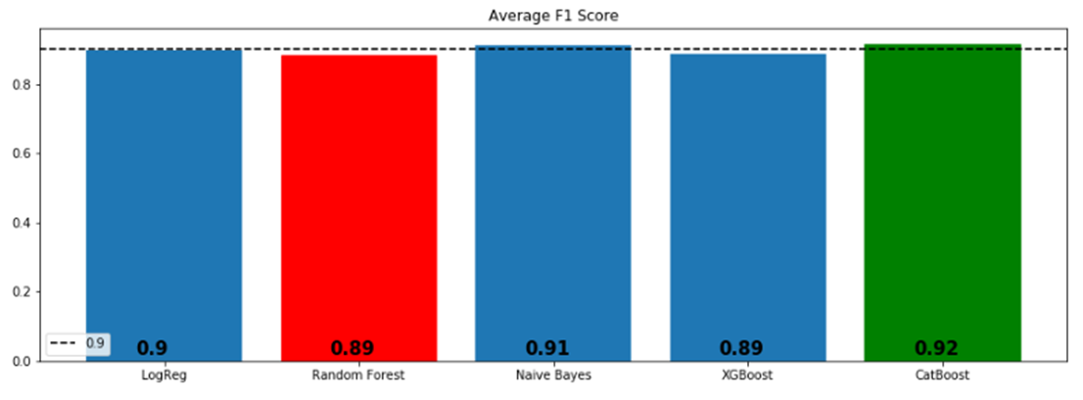
Count-Vectorizing and Algorithms Adding Most and Least Common Words to Stopwords List
Problem Definition & Understanding
Data Retrieval
Data Wrangling
Text Preprocessing
Exploratory Data Analysis
Transforming Data
Preparing the Model
Training Model
Evaluation
Model Improvement &
Evaluation
Testing
Conclusion

Slide 29
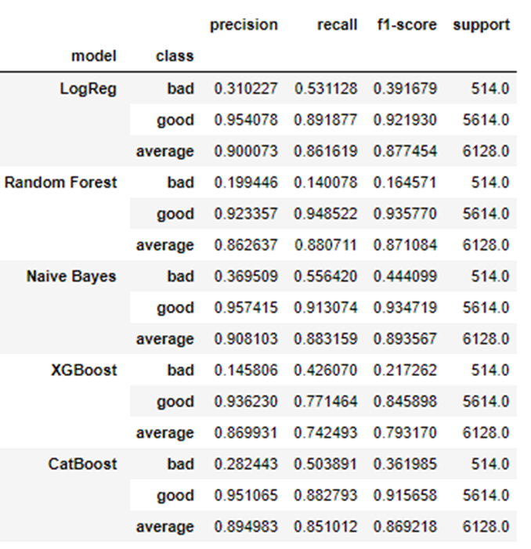
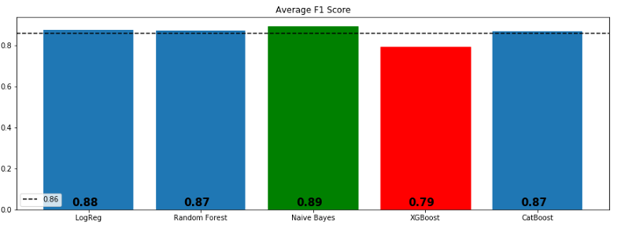
Count-Vectorizing and Algorithms Synthetic Minority Oversampling Technique (SMOTE)
Problem Definition & Understanding
Data Retrieval
Data Wrangling
Text Preprocessing
Exploratory Data Analysis
Transforming Data
Preparing the Model
Training Model
Evaluation
Model Improvement &
Evaluation
Testing
Conclusion

Slide 30
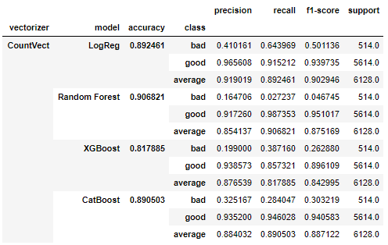
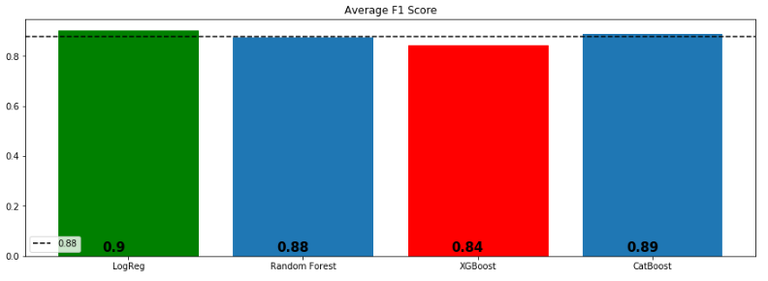
Count-Vectorizing and Algorithms PCA + SMOTE
Problem Definition & Understanding
Data Retrieval
Data Wrangling
Text Preprocessing
Exploratory Data Analysis
Transforming Data
Preparing the Model
Training Model
Evaluation
Model Improvement &
Evaluation
Testing
Conclusion

Slide 31
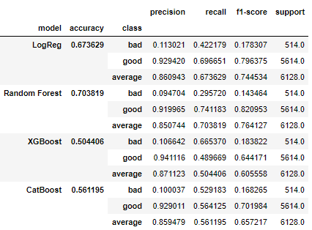
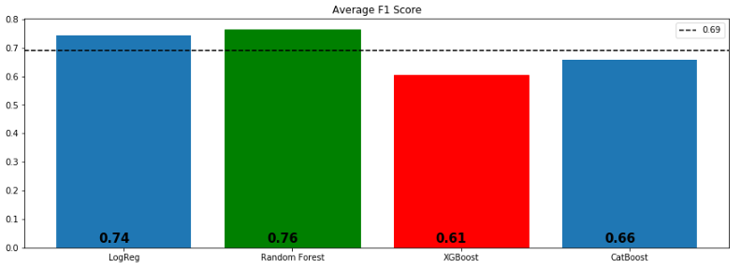
Count-Vectorizing and Algorithms Truncated SVD + SMOTE
Problem Definition & Understanding
Data Retrieval
Data Wrangling
Text Preprocessing
Exploratory Data Analysis
Transforming Data
Preparing the Model
Training Model
Evaluation
Model Improvement &
Evaluation
Word2Vec
Conclusion

Slide 32
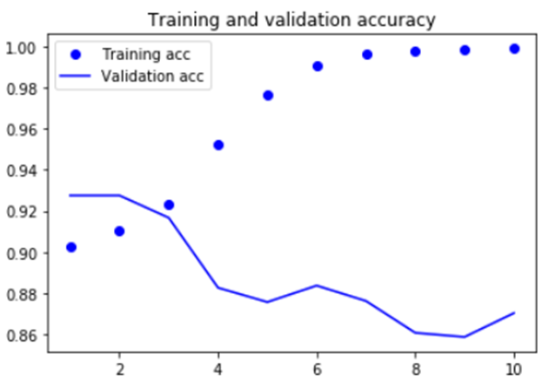
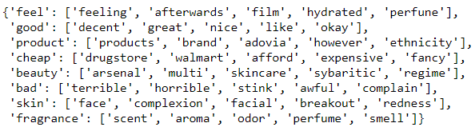
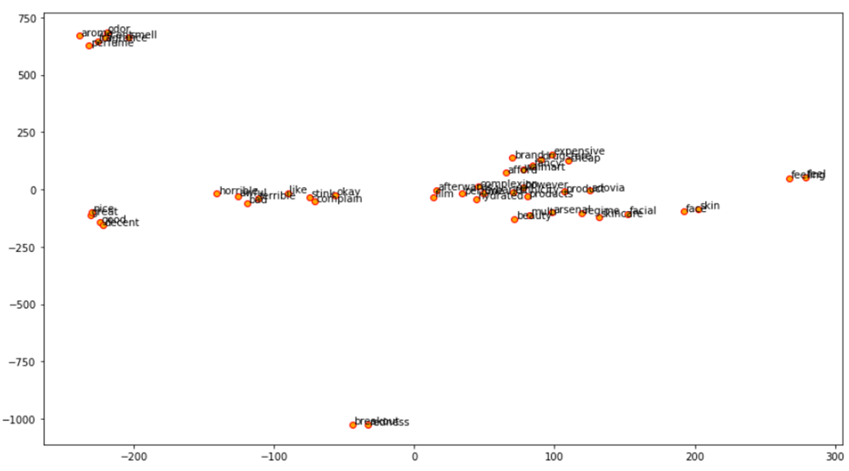
Word2Vec and Simple Neural Network
Problem Definition & Understanding
Data Retrieval
Data Wrangling
Text Preprocessing
Exploratory Data Analysis
Transforming Data
Preparing the Model
Training Model
Visualization of the words of interest and their similar words using their embedding vectors after reducing their dimensions to a 2-D space with t-SNE
Evaluation
Model Improvement &
Evaluation
Word2Vec
Conclusion

Slide 33
Conclusion
Problem Definition & Understanding
* In this project, I tried to predict the good and bad words based on the reviews left by the e-customers.
* We applied;
- Count Vector, TF-IDF, Hashing Vector, Word2Vec
- Classification Models and Simple Neural Network
- Adding most and lest common words to CountVect
- SMOTE,
- PCA + SMOTE
- Truncated SVD + SMOTE
Data Retrieval
Data Wrangling
Text Preprocessing
Exploratory Data Analysis
Transforming Data
Preparing the Model
Training Model
Evaluation
Model Improvement &
Evaluation
Word2Vec
Conclusion

Slide 34
Conclusion
Problem Definition & Understanding
Data Retrieval
*nBoosting algorithms were the winners almost each combinations.
*nI will go with Naïve Bayes with Count Vectorizing in deploying section (f1 score is 0.924423).
*nAdding most and least common words to the stopword list didn’t have impact on models’ performance.
*nSMOTE and Linear Dimensionality Reduction techniques decreased the f-1 scores.
Data Wrangling
Text Preprocessing
Exploratory Data Analysis
Transforming Data
Preparing the Model
Training Model
Evaluation
Model Improvement &
Evaluation
Word2Vec
Conclusion

Slide 35
Conclusion - Recommendations
Problem Definition & Understanding
Data Retrieval
Data Wrangling
Text Preprocessing
We recommend the client to use the model as it is and give us some time to develop neural network algorithms to get better scores. By the way, prediction time and the size of the data set are also important and need to be considered.
Especially neural network algorithms may not be outperforming with the low size data sets.
Exploratory Data Analysis
Transforming Data
Preparing the Model
Training Model
Evaluation
Model Improvement &
Evaluation
Word2Vec
Conclusion

Slide 36
Conclusion - Recommendations
Problem Definition & Understanding
Data Retrieval
* Provide a system that user can write their reviews/feedbacks without grammatical mistakes such as not accepting the review if it does not satisfy the word/grammar correctness.
* Encourage users to reflect their experience with products via giving incentives.
* Use the reviews as a feedback mechanism, take actions towards them, and let the customers know about the conclusion.
Data Wrangling
Text Preprocessing
Exploratory Data Analysis
Transforming Data
Preparing the Model
Training Model
Evaluation
Model Improvement &
Evaluation
Word2Vec
Helps to Provide Steady Training Dataset
Conclusion

Slide 37
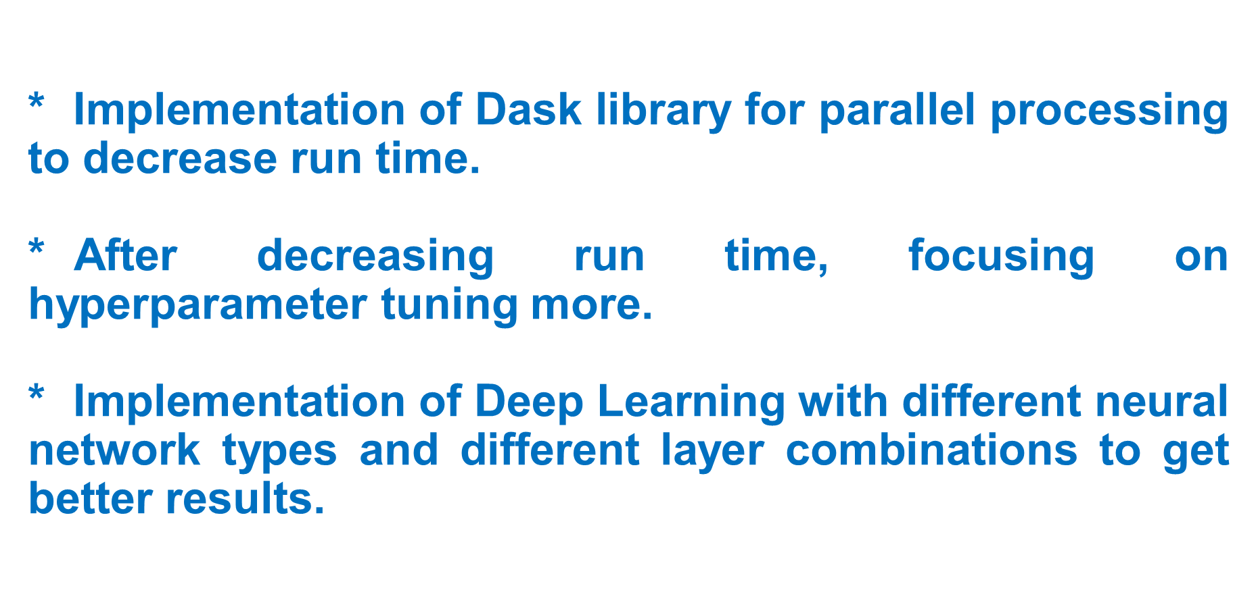
Conclusion- Future Study
Problem Definition & Understanding
Data Retrieval
Data Wrangling
Text Preprocessing
Exploratory Data Analysis
Transforming Data
Preparing the Model
Training Model
Evaluation
Model Improvement &
Evaluation
Word2Vec
Conclusion

